Slide 1
Organizational Design Step 2 STRATEGY
Nihan AKIN

Slide 2
Agenda
Introduction to Strategy
4 Strategy Types (Miles & Snow,1978)
Reactor
Defender
Prospector
Analyzer
Without innovation
With innovation
Strategy – Diagnostic Questions
Fit between strategy and organizational goals

Slide 3
Strategy
A firm’s strategy helps determine its organizational design.
Chandler (1962) stated « Structure follows strategy». He defined structure as the design of the organization through which strategy is administered
Strategy is the operationalization of the firm’s goals of efficiency and/or effectiveness.

Slide 4
Strategy
A firm’s strategy reflects management’s assesments of the firm’s situation and it’s choice of how to pursue the firm’s goals.
Exploration and exploitation are dimensions of strategy that can be used to form the basis for categorization of a firm’s strategy into four types.

Slide 5
4 Strategy Types (Miles & Snow,1978)
Reactor
Defender
Prospector
Analyzer
Without innovation
With innovation

Slide 6
The Strategy Space
Exploitation
High
Analyzer without
innovation
Defender
Analyzer with
innovation
Low
Exploration
High
Reactor
Prospector
Low

Slide 7

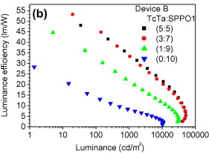
Exploration vs Exploitation
Exploration includes search, variation, risk taking and innovation.
Exploitation includes refinement, efficiency, selection and implementation.

Slide 8
The Strategy Space - Reactor
Exploitation
High
Analyzer without
innovation
Defender
Analyzer with
innovation
Low
Exploration
High
Reactor
Prospector
Low

Slide 9

Strategy - Reactor
Neither an explorer nor an exploiter.
Acts without a focus on exploration or exploitation.
Reacts after a situation has occured. (Customer reactions, market situations etc.)
There is no innovation.
Executive does not systematically anticipate, plan or project in the future.
There is not a good example, they die often.

Slide 10

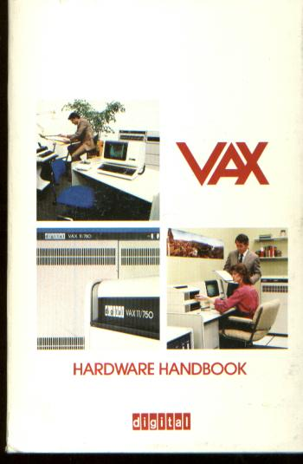
Strategy - Reactor
Digital Corporation is a good example.
Could not catch PC trend.
Sold to HP while in big loss.

Slide 11
The Strategy Space - Defender
Exploitation
High
Analyzer without
innovation
Defender
Analyzer with
innovation
Low
Exploration
High
Reactor
Prospector
Low

Slide 12

Strategy - Defender
They are high on exploiting their resources but low on exploring anything or being innovative.
Executives are focused on keeping the organization’s position in the market.
There is an emphasis on maintaining a competitive position.
Sales forecasting is a frequent tool to used to support the defender strategy.
They can not change quickly.
Vulnerablity comes when its products or services are no longer desired in the market.
Also they can be affected from new regulations.

Slide 13

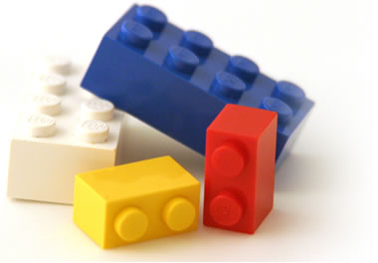

Strategy - Defender

Slide 14
The Strategy Space - Prospector
Exploitation
High
Analyzer without
innovation
Defender
Analyzer with
innovation
Low
Exploration
High
Reactor
Prospector
Low

Slide 15

Strategy - Prospector
They are high on exploration of its opportunities but low on exploiting its current situation.
They focus on innovation.
Maintains its competitive position by being new and making changes to the competitive situation that others must adjust too.
They can make rapid changes.
Efficiency is low.
Change oriented.
Downside is, they can quickly exhaust their resources.
Another vulnerablity they have to innovate continuously.

Slide 16



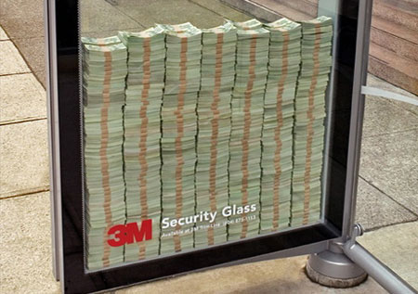
Strategy - Prospector

Slide 17
The Strategy Space Analyzer without innovation
Exploitation
High
Analyzer without
innovation
Defender
Analyzer with
innovation
Low
Exploration
High
Reactor
Prospector
Low

Slide 18
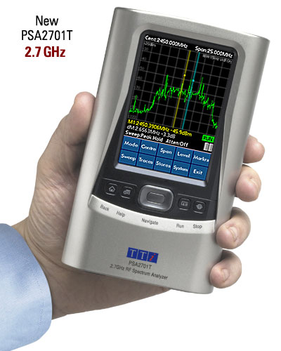
Strategy - Analyzer without innovation
Very similar to defender except they have passive innovation strategy.
Uses new tools and services that others created.
They are quick follower.
Maintaints its position by being efficient.
They can make small changes in their existing products and services.

Slide 19

Strategy - Analyzer without innovation
For example,
Dress producers go to Paris for analyzing the latest fashion trends.

Slide 20
The Strategy Space – Analyzer with innovation
Exploitation
High
Analyzer without
innovation
Defender
Analyzer with
innovation
Low
Exploration
High
Reactor
Prospector
Low

Slide 21

Strategy - Analyzer with innovation
They have dual strategy.
They do two things at a time.
They innovate in purpose.
They have more stable positions according to other types.
Vulnerablity comes from maintaining this duality.

Slide 22
Strategy – Diagnostic Questions
Exploration
How innovative are the organization’s products?
What is the price compared to the value of product?
What is the price compared to the quality level?
How frequently does the firm develop new products?
How difficult is it for other firms to develop related products?

Slide 23
Strategy – Diagnostic Questions
Exploitation
What is the organization’s degree of process innovation ?
What are its prices compared to the competition?
What is its quality in terms of standardization and reliability?
What is the number of products the organization has compared to its competitors?
What are the barriers to entry in its industry?

Slide 24
Fit between strategy and organizational goals
Corresponding quadrant in organizational design space | A | B | C | D
Strategy Types | Reactor | Defender | Prospector | Analyzer with innovation | Analyzer without innovation
Organizational Goals | Neither | Efficiency | Effectiveness | Efficiency and Effectiveness

Slide 25
Thank You!

